Slide 1
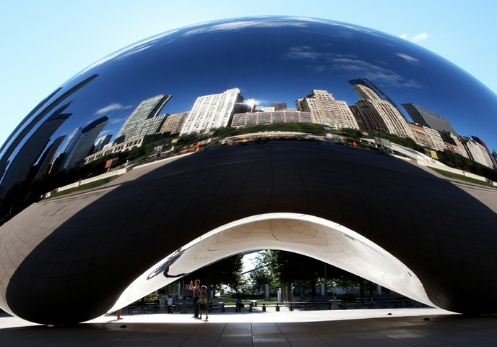
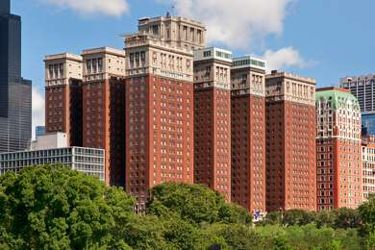
SOAP 54th Annual Meeting May 11-15, 2022 Hilton Chicago Hotel Chicago, Illinois
soap.org

